Slide 1
Making STM a
global standard
Imagine if all information to and from 100s of 1000s of vessels across the world was digitalized and transacted over one common infrastructure
Using one global standard

Slide 2
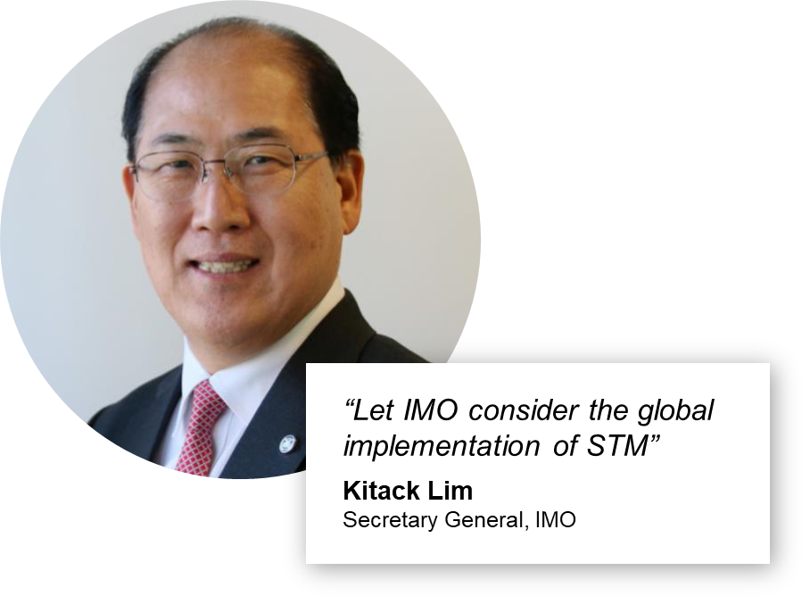
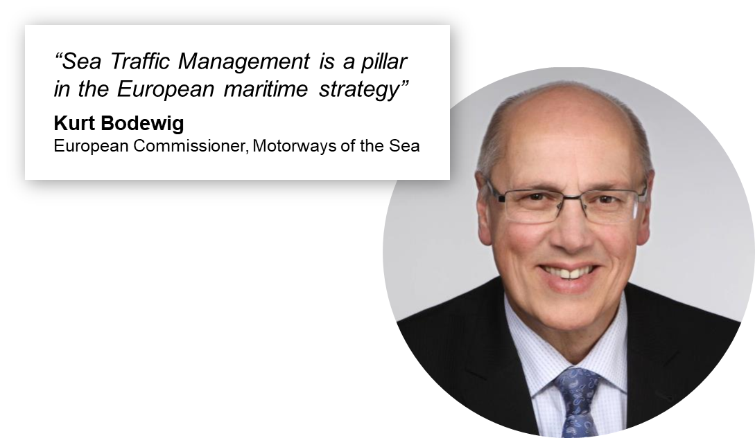
Since some time we have a joint vision!
STM projects have established a powerful digital maritime infrastructure for interoperability by:
  defining & verifying a technical infrastructure, components & protocols
  proving the digital infrastructure through live testbeds
  verifying efficiency impact and safety & environmental benefits
Authorities and institutions have recognised the work and the need – for example at IMO last November
Ship operators & industry players
are also seeing the benefit!
Notes:
Today there is no global standard for digital maritime information exchange & validation of exchanging parties
Some proprietary commercial services offered by large ship operators but non-commercial ship-shore services (such as ETD/ETA etc.) not yet standardized making it difficult to achieve efficiency and scaling
Ship operators, ports and other authoritative entities can improve efficiency, safety and environmental impact
Equipment manufacturers can more easy pursuit and attract new revenue streams, e.g. moving from products to products and services
Service providers and integrators can scale their services offerings to embrace a larger customer base with same services
Resounding agreement from public, academic & commercial bodies in London conference (Nov-18), indicating ambition to establish & endorse a standard to secure interoperability & unleash potentials from digitalization
STM increasingly demanded in RFQs from authorities, included in BIMCO standard contracts, and manufacturers & services providers are now building STM into their solutions

Slide 3
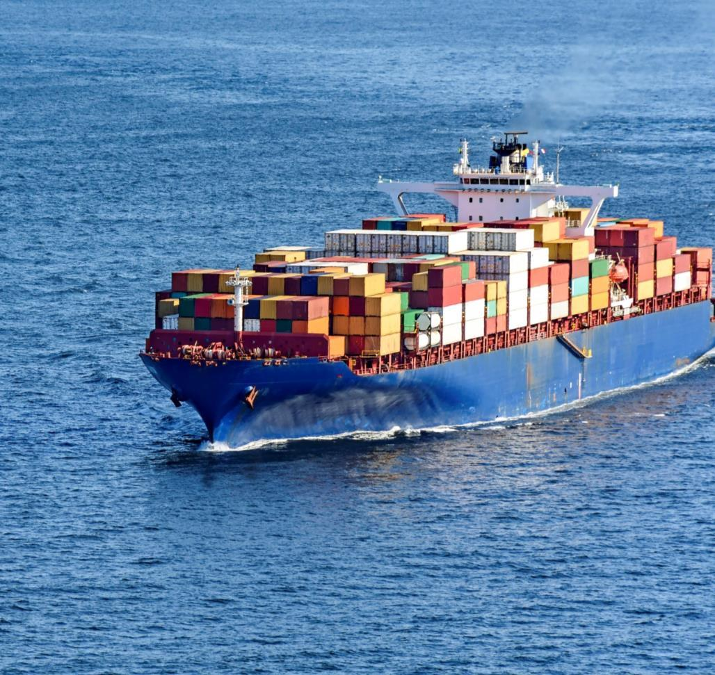
A vision becomes a standard when all actors commit and dedicate!
Finding an owner that ensures governance and drive adoption
Business partners
adopt & implement
Authorities endorse
All parties start using
Notes:
The increasing need for efficiencies, safety & environmental improvements through digitalisation drives a need for a standardised digital maritime infrastructure
The STM Validation Project outcomes, know-how and test infrastructure are now available, free of charge, for anybody to operationalize on up until mid 2019
Without a continued multilateral approach, large players may look to drive their own development or the opportunity may be seized by unicorns such as Amazon or similar
Emergence of such proprietary platforms will prevent interoperability between all actors and will likely lead to lesser uptake and realization of benefits
Proprietary platforms will be designed to mainly benefit individual interests, and these parties will control the pricing
Establishing STM Governance Org. would seize the vacant opportunity in a standardized way, and ensure alignment of platform, infrastructure, security and pricing, along with driving the future development for the whole eco-system.

Slide 4
What does it take to fulfil the vision?
Established governance organisation
Tech set-up to run the infrastructure
Dedicated team to govern,
service, maintain and develop
Manufacturers and service providers
implementing standard in their products
Governing bodies support with directives
XMAs & business partners request in their operations
…
In short:
This will require robust commitments, joint investments and an “open-mind-to-make-it-work”

Slide 5

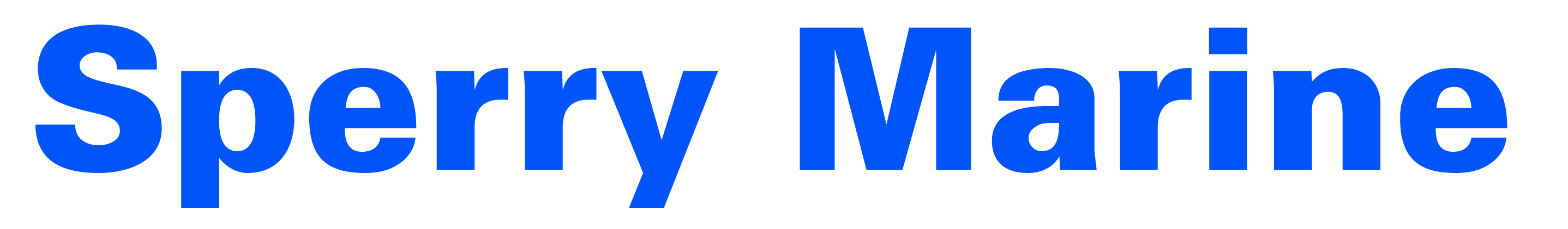






How to fill the empty seat?
An industry group is now
exploring how this can happen:
Terms and structure of a joint collaboration
Operational set up
How to engage the sector and get commitment from all actors
What is the market maturity
and what is the business case
Notes:
That we have agreed/are looking to agree (depending on…) to collaborate, why companies are doiong that, what they hope to achieve and how they aim to support/drive the development in the maritime industry, but also that it is costing money and that it is unclear if there is a business case for doing this now versus stay outside and wait and join later, why it is still important that somebody get together to make this happen

Slide 6
Right now we are …
…looking to find answers to some vital questions :
How will the STM infrastructure technology scale and continue deliver value?
Who will benefit from the global standard, and how?
What services will the users need/expect in the future?
Who is willing to pay for the benefits, and how much?
Is there commitment from all stakeholders in the sector?
What is the optimal business and operating model?
How will such a governance organisation be endorsed?
How can such a governance organisation be funded?
Notes:
What we are doing right now, looking at technical stuff, market readiness, who needs this, who gets benefits, who is ready to pay, how does states and acacemia benefit from this, operating model, business model and so on, but also see tat it is realistic to get this up and running to 1/7 if we all collaborate
The infrastructure from the SM Validation project is scalable, has relevant interfaces and is built with optimal components
The costs for taking over the test bed infrastructure and implementing it in a production environment are at reasonable level, and the resources needed for this can also be supported by the current STM Validation Project (before June ‘19)
Cost for running the Governance organization can be partly supported by members in-kind funding, and remaining costs can be held at a level that ensures each member see a valid business case supporting any monetary investments
The market is mature, can see the value proposed by a governed STM, and is willing to pay for services related to validation, authentication and certification delivered by a future STM Governance Org. to a degree that presents a sustainable business case
An STM Governance org will be a powerful body for lobbying relevant institutions and organizations in the maritime sector
The optimal initial organization set up is one where validation, authentication and certification services are licensed on a commercial basis, and the revenue is used to either pay back any investments made by members or invest in further development of the infrastructure.

Slide 7
And reach our common ambition
To have a governance organisation up and running ready to take over from the STM Validation project when it ends in June 2019:
  How can we make this deadline happen together with other stakeholders and beneficiaries?
...so that we can realise the real-world benefits that are possible commercially, societally and environmentally!

Slide 8
We need your support to succeed!
Notes:
We still need all your help between now and summer to make this a reality and achieve the collective maritime benefits that the STM projects have invested for
How much money EU has plowed in, what can happen if we make it work, what we need from each different party in the audience (not in detail but in principle), political commitment, co-funding, preparedness to pay for usage, collaboration with academia etc and that we are there during the conference evening/tomorrow to listen and discuss – reach out to us

Slide 9

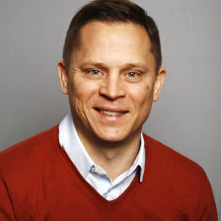

Thank you!
Reach out – we are here
tonight and tomorrow!
Tina Dejan
Erik Daren
Gillian Comley

